Slide 1
Background ?
Description of the current code and Expectations ?

Slide 2
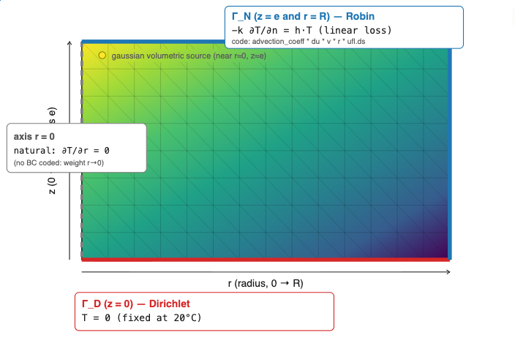
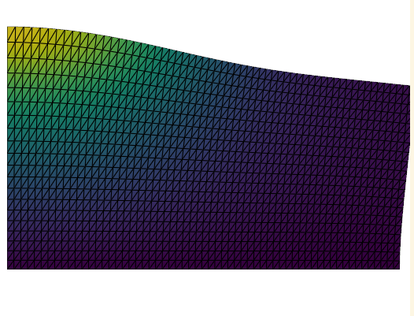
Current State
Well structured notebook
Axi-symmetric cylinder

Slide 3
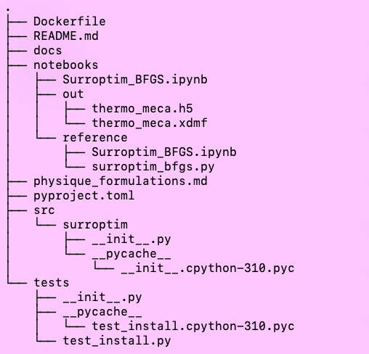
Proposed structure
Similarly to the initial notebook:
- Install
- Tools (Fucntions and Classes)
- Compute
- Post-Proc
+ diff following

Slide 4

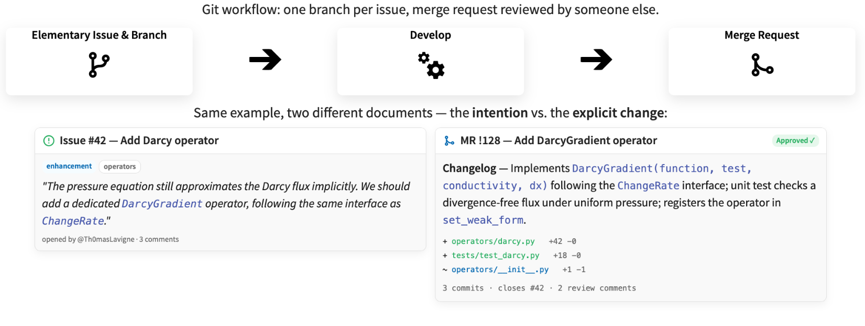

Slide 8
!
Need to explicitly import dolfinx.fem.petsc:
It is a separated submodule because dolfinx needs to be able to import without petsc in some contexts

Slide 9
Add a radial flux
1. start with a non physical radiation to keep the linear solver.
2. do the same for a non linear solver: output should be the same & compare it to the residual defined in src/surroptim/weak_form
3. Final version towards calibration

Slide 10
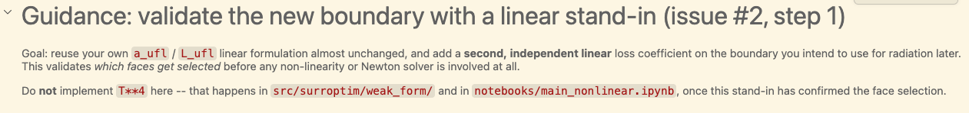
1. start with a non physical radiation to keep the linear solver.

Slide 11
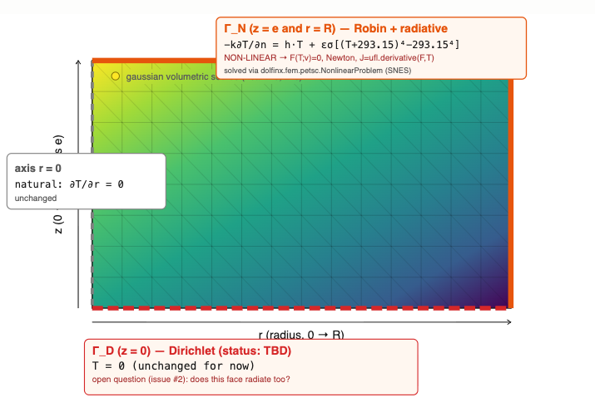
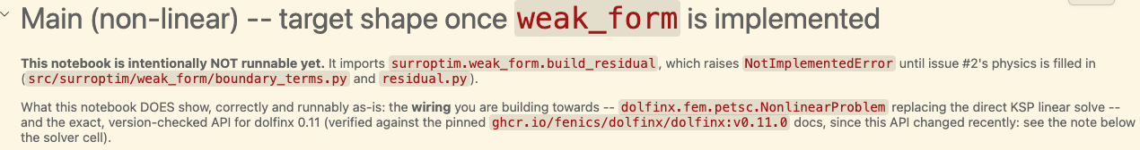
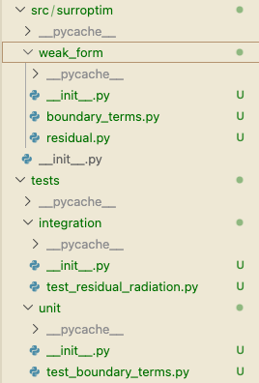
2. do the same for a non linear solver: output should be the same & compare it to the residual defined in src/surroptim/weak_form
Templates

